Slide 1
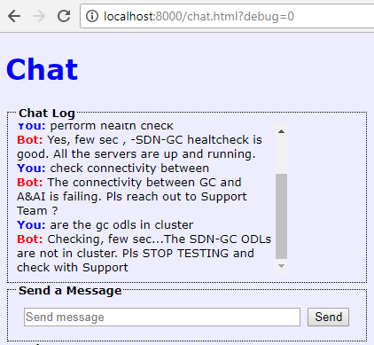
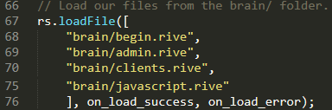
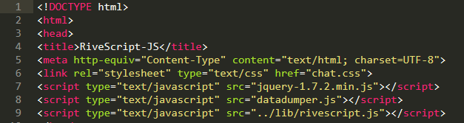
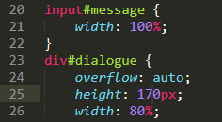
ChatBot Proof of Concept (PoC) II
ChatBot provide a quick, convenient web-client interface interact with users and it triggers at certain event such as “search” for info
RS java is a simple ChatBot API that is easy to use and sufficed for our needs via loading the brain AI rive files
Run the web-client to turn into a web-client ChatBot
HTML ChatBot
Draft
Cascading Style Sheet ChatBot

